Slide 1
Nipple and Skin Sparing Mastectomy
Ready for Prime Time?

Slide 2
Edibaldo Silva, M.D., PhD., F.A.C.S.
Professor
Division of Surgical Oncology
Department of Surgery
Nebraska Medical Center
Omaha, NE

Slide 3
NCI Consensus Conference- 1991
Endorsed breast conservation as the preferred treatment of early-stage breast cancer
Veronesi et al NEJM 305: 611 (1981)
Fisher et al NEJM 312: 674 (1985)

Slide 4
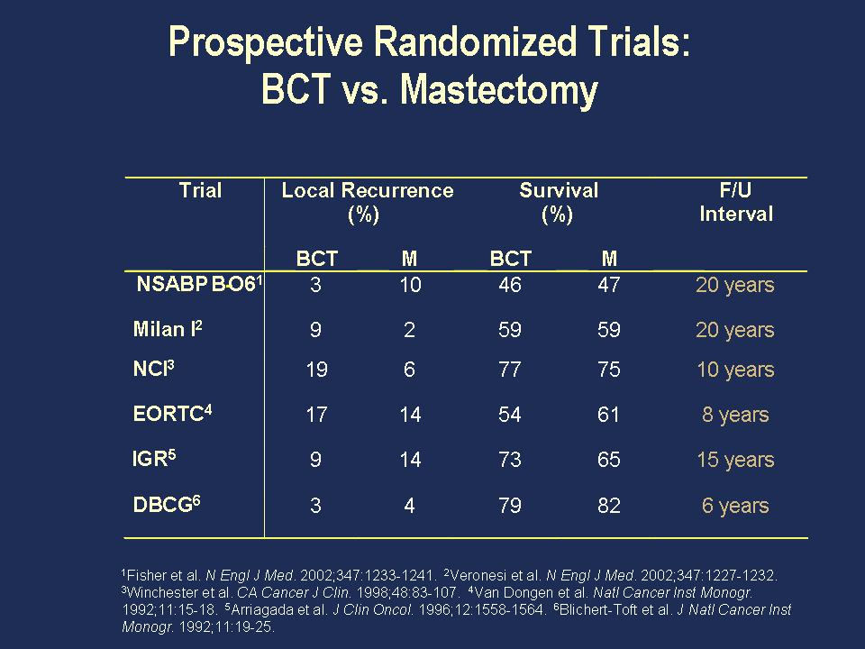
Notes:
In node negative post menopausal ER/PR positive, Her 2 negative patients the 20 year disease free survival approximates 96%!

Slide 5
National Accreditation Program for Breast Centers - 2010
Standard 2.3:
At least 50 % of all patients with early stage breast cancer are treated with breast conserving surgery.

Slide 6
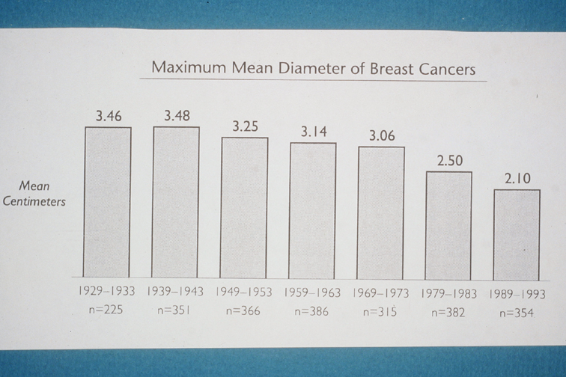

Slide 7
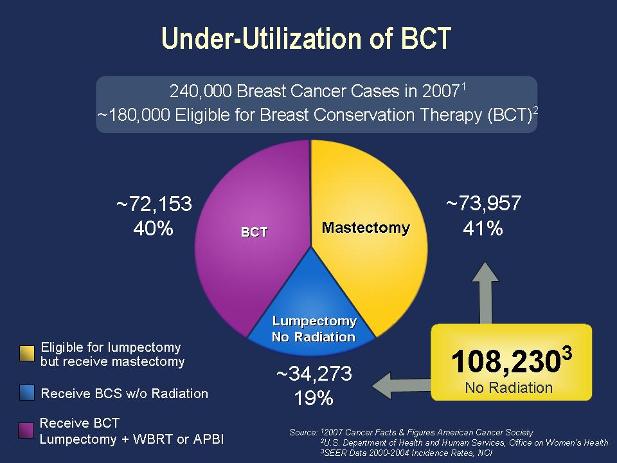
Notes:
This despite the fact that the average size of breast cancers diagnosed today is <2cm!

Slide 8
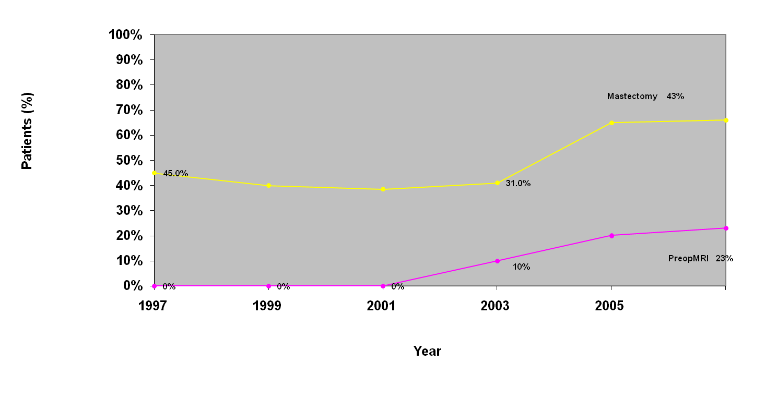
MRI & Decrease in BCS
The recent rise in the proportion of early-stage patients undergoing mastectomy (2003-2006) appears to correspond to a rise in the proportion obtaining preoperative MRI.
Katipamula R, ASCO 2008, abstr 509
Notes:
MRI use among Medicare patients increased 3-fold (3440 to 10115) between 2001 & 2003. Bluemke D., et al., JAMA 292 (22): 2735-2742. (2004) Similar trend was noted earlier by Ted Tuttle in a SEER study and Bleicher at Fox Chase.

Slide 9
Notes:
Who is to blame for this trend? Surgeons, in part, for not doing a better job w/ BCS. Note that 55% (153/276) of patients choosing BCS undergo a subsequent mastectomy to clear positive margins of the BCS specimen.

Slide 10
Notes:
Note that the lower curve intersects the upper curve very late (>96 mo. Post op) and that these are likely second cancers not primary tumor recurrences.

Slide 11
NSSM
Recent studies of BCS vs. MRM for T1-2 N0-1 M0 breast cancer in young and old women confirm that:
Even for women under age 40 lumpectomy and radiation with appropriate systemic therapy is equivalent to or slightly better than mastectomy with locoregional failure rates of 4.6% and 8.5% at 5 years and 8.5% and 10.8% respectively for BCS vs. mastectomy.
BCS is more effective than mastectomy for triple negative breast cancers with LRR rates of 4% vs. 10% respectively with mean follow-up of 7.8 years.
Buckley et al., 2011 Breast CA Symp.
Abstr 70, Sept 8, 2011
Mahmood et al., 2011 Breat CA Symp.
Abstr 85, Sept 8, 2011
Abchl Karim et al. JCO 29:2852-58, 2011
Notes:
Similar data was published by Hwang SE et al. Survival after lumpectomy and mastectomy for early stage breast invasive breast cancer. The effect of age and hormone receptor status. Cancer; published on line 00 Month 2012, DOI: 10.1002/cncr.27795

Slide 12
Who must have a mastectomy?
Patients whose cancer has grown through the skin or fixed to chest wall (T4 lesions).
Patients whose cancer or DCIS is synchronously present in multiple areas of the same breast (~3%)
Patients who cannot undergo radiation therapy after lumpectomy (s/p RT for Hodgkin lymphoma)
Patients with inflammatory breast cancer (1-3%).
Patients undergoing prophylactic or therapeutic mastectomy for BRCA positive disease.
Notes:
Patients w/ Hodgkin’s treated w/ RT under age 25 have a lifelong breast Ca risk of ~34% and should start breast screening at age 30.

Slide 13
Preventive contralateral mastectomy for BRCA gene non-carriers- why not do it?

Slide 14
Notes:
NOTE: The age group 25 29 is higher expectedly due to its inclusion of potential BRCA carriers. Note that all of these odds are cut by more than half when women are treated with chemotherapy and hormone blockade. In a woman 60-80 years old the risk of cancer in the opposite breast would effectively be 0.15% per year or 1.5% ten years after her initial diagnosis. None of these women will die of the second cancer but of the cancer they already have.
Ref:
Nichols H, Berrington de Gonzalez A, Lacey J, Rosenberg P, Anderson W. Declining Incidence of Contralateral Breast Cancer in the USA from 1975-2006. JCO: 29 (12): 1564-1569.

Slide 15
What is nipple and skin sparing mastectomy (NSSP)?
It is NOT a SQ mastectomy
Relies on thin skin flaps developed at the inter phase between the SQ fat and the glandular tissue
The nipple areola complex is effaced with ~3-7 mm. thickness preferable
Intraoperative frozen section assessment of the retroareolar tissue is preferred

Slide 16
Local Management of Invasive Breast Cancer
William Halstead | 1894 | Radical mastectomy
B. S. Freeman | 1964 | SQ mastectomy
Jerome Urban | 1978 | Ultra radical mastectomy
L. Turner | 1981 | MRM
U. Veronisi | 1981 | Quadrantectomy
C. Hinton | 1984 | SQ mastectomy
B. Fisher | 1989 | Lumpectomy
B. Gerber | 2003 | NSS/mastectomy

Slide 17
Table 1: Reported rates of recurrence after nipple sparing mastectomy for breast cancer
Giuliano etal
Ann Surg Onc 2011
Notes:
Not selected patients w/ large tumors and node positive disease. Note very long f/u period
Recurrence in nipple only or w/local elsewhere failure is -4%
Skip flap recurrences range from 0-24%
Benediktsson’s study: 40% were node positive patients, 53% were Stage II and III, LR @ 12 years was 24% c/w other reports for node positive patients, yet NAC was 4%
.

Slide 18
NSSM
Indirect Evidence of Safety
Breast conserving surgery trials never showed that nipple removal with mastectomy affected survival
Local recurrences in BCS trials of lumpectomy alone, lumpectomy and radiation, versus mastectomy do not show a predilection for nipple vs “elsewhere” recurrences
Recent trials of accelerated partial (no nipple radiation) breast radiation with BCS do not show any predilection for nipple recurrences.
Old series on NSSM included node positive patients and in some series Stage II and Stage III patients accounted for more than 50% of patients (Benediktsson).
MRI was not used in old series’ for patient selection.
Nipple involvement has not been documented in prophylactic mastectomy.

Slide 19
NSSM
Reluctance to accept NSSM in the academic community was fueled by concern for the presence of synchronous in-breast microscopic involvement of the nipple in treated patients with a known breast cancer despite any clinical evidence of disproportionate nipple recurrence.

Slide 20
Table 1. Selected Previous Studies on Nipple Involvement by Carcinoma
Notes:
1) These older series show significant histologic nipple involvement due for the selection of patients with very advanced cancers with nodal metastases.
2) None of the prophylactic mastectomies had nipple involvement

Slide 21
Where should one look for nipple or retroareolar involvement?
Within a depth of 3 mm. from the skin which contains the lactiferous duct bundle.
The consistent pattern of contiguous spread from the main tumor into the nipple allows histologic analysis of the retroareolar tissue or margin which represents the lactiferous bundle as it is exiting the breast. parenchyma toward the nipple to reliably indicate whether or not distal nipple structures are involved by tumor.

Slide 22
Histologic Assessment of Retroareolar margin in patients undergoing mastectomy for breast cancer
N= 316 unselected conservative mastectomies
    232 therapeutic
    84 prophylactic
Exclusion criteria
    BRCA patients
    T4 lesions
    Paget’s
    No clinically evident nipple involvement (retraction deviation ulceration)
Mean age 47 (prophylaxis) – 40% postmenopausal
    56 (therapeutic) – 60% postmenopausal
Neoadjuvant chemotherapy 11%
Average geographic separation of primary tumor from nipple = 4.4 cm.
Brachtel et al JCO30:4948-4956, 2009

Slide 23
Histologic Assessment of Retroareolar Margin in patients undergoing mastectomy for breast cancer
Performed 3D reconstruction of coronal serial sections of all nipple – retroareolar tissue
20% of studied specimens had histologic nipple involvement
62% of all nipple involvement was DCIS, only 4% was IDC
No nipple involvement was noted in prophylactic mastectomy
Negative assessment of nipple is 80% sensitive with a negative predictive value of 96%
Brachtel et al. JCO 30:4948-4956
2009

Slide 24
Figure 2 – Brachtel paper

Slide 25
Figure 4

Slide 26
Preoperative Predictor of Nipple Involvement
Tumor size *
Tumor to nipple distance*
HER2 positive tumors*
High grade
Clinically positive axillary nodes
*Denotes statistical significant in multivariate analysis
Notes:
Neoadjuvant chemo would help to minimize odds of nipple involvement

Slide 27
Summary of serial histologic sections of nipple areolar margin
Nipple involvement in therapeutic mastectomy for non -T4 lesions is 20%
62% occult nipple involvement is DCIS
Local recurrence patterns for BCS do not show a 20% failure at nipple
The histologic presence of cancer in the defined retroareolar tissue correlates with occult nipple involvement
Prophylactic mastectomy does not show occult nipple involvement

Slide 28
Advantage of using retroareolar margin for excluding occult nipple involvement with NSSN
Minimizes vascular insult to NAC caused by “nipple coring”
Leads to better projection of NAC

Slide 29
Who is a candidate for NSSM? Why bother?
Diffuse DCIS
Multifocal small primary invasive tumors
Prophylactic mastectomy for BRCA or other known mutations (ideal cohort)
Patients with small cup size and minimal ptosis thus excluding large ptotic breasts

Slide 30
Who is NOT a candidate for NSS mastectomy?
All T4 lesions
Patients with previous multiple scars which may affect blood supply of skin
Large pendulous breasts
Previously radiated BCS failures
Bulky axillary disease
Tumor directly behind or within 2 cm. of NAC

Slide 31
Potential complications of NSS mastectomy
Residual tumor at NAC-requiring nipple/areolar resection post op
Necrosis of skin flaps
Necrosis of nipple
Increased rate of local recurrence in unselected patients
Loss of implant (infections etc.)

Slide 32
Oncological Safety of Skin Sparing Mastectomy for invasive cancer

Slide 33
Oncological Safety of NSS Mastectomy for Cancer (contemporary series)
Notes:
No nipple recurrences documented in patients who had negative retroareolar frozen section or permanent H&E.
In none of the reported series is the low rate of nipple recurrence greater than that of flap recurrence.

Slide 34
Early results of therapeutic & prophylactic NSSM w/ immediate reconstruction in BRCA mutation carriers (Lei et al. P1 poster-SSO March 6, 2013)
N= 70 (140 breasts) Median f/u: 11 mo.
113 (80%) patients-prophylactic & 27 (19%) patients-therapeutic
2/133 preventive specimens had CA (1 DCIS,1IDC)
LR: 0/113 preventive & 2/27 in therapeutic arm
LR: no nipple recurrence/1 axilla/1 chest wall

Slide 35
Potential Complications of NSSM
Residual tumor at the NAC is excluded with retroareolar biopsy with a 96% negative predictive value.
Remaining events can be excluded by permanent H&E requiring delayed resection of NAC.
No NAC involvement has been documented in studies of prophylactic mastectomy for high risk patients.

Slide 36
Potential Complications of NSSM
Necrosis of NAC can occur in up to 15% of patients but partial necrosis can often be managed conservatively
Loss of implant is a rare event

Slide 37
Risk Factors for Nipple Necrosis
Nipple to suprasternal notch distance greater than 28 cm.
Previous periareolar scars
Smoking

Slide 38
Optimizing results when using a NSSM
Preop chemotherapy in those patients who meet criteria for chemo on presentation
MRI can exclude patients with retroareolar involvement and may suggest preop chemo for potentially close margins
Use intraoperative frozen section assessment of retroareolar tissue
Modify infra-mammary incision (lateral shift) for axillary sentinel node staging
Preop chemo decreases margin positive rate, and indications for post-mastectomy radiation
Notes:
Ref: Steen S, Chung A, Han SH, et. al. Predicting Nipple-Areolar Involvement Using Preoperative MRI and Primary Tumor Characteristics. Ann Surg Oncol 20: 633-639, 2013.

Slide 39
NSSM for Prophylaxis
No NAC documented on intraoperative histologic assessment
Large series including those using SQ mastectomy (Hartman NEJM 1998) have shown no significant nipple recurrences (1) or local recurrences (7) with long follow up (8 yrs). N= 1065, 12% BRCA positive.

Slide 40
Reconstructive Options
Subpectoral permanent implant
Subpectoral tissue expander
TRAM
Latissimus flap
DIEP
Free flap

Slide 41
Skin sparing mastectomy and radiation
Delay autologous tissue transfer
Prefer subpectoral immediate placement of tissue expanders
Capsule contraction in patients electing implants for reconstruction may be addressed at time of switch
Small series using NSSM and RT show comparable approaches are useful.
- Mokbel. Intl Sem in SurgOnc 2006

Slide 42
NSSM Summary
NSSM is oncologically safe in well selected patients with invasive cancer or DCIS
NSSM is an excellent option for prophylactic mastectomy
All of the well established BCS data has suggested that nipple removal does not confer a survival advantage
NAC recurrence as sole site of LR is very rare
LR in mastectomy flaps with or without NAC preservation is comparable in selected patient trials
Cosmetic results particularly in prophylactic mastectomy cases are superior
Psychological benefit may be substantial

Slide 43
NSSM Summary
For most women with breast cancer BCS is the preferred option.
The coordinated use of systemic therapy can maximize the odds of BCS in most women.
NSSM is an ideal option for prophylactic mastectomy and for well selected CA patients who have no choice but mastectomy.

Slide 44
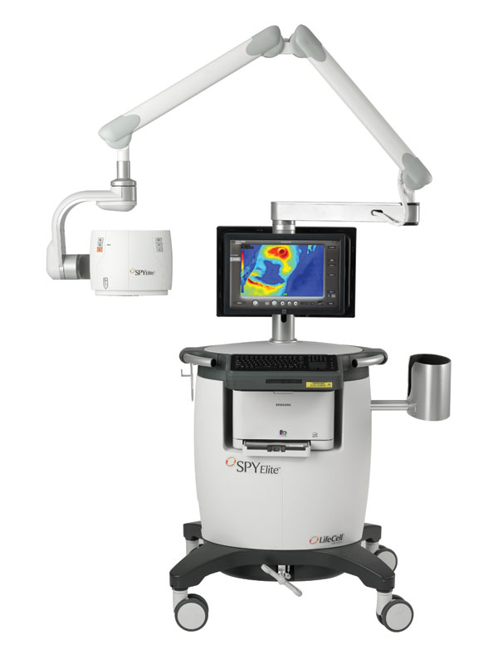
Notes:
UNMC first to use this in Omaha.

Slide 45
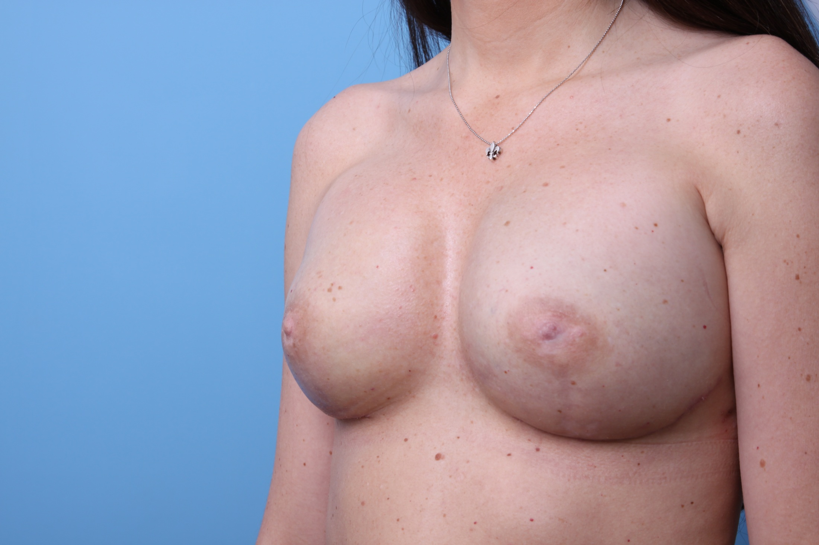

Slide 46
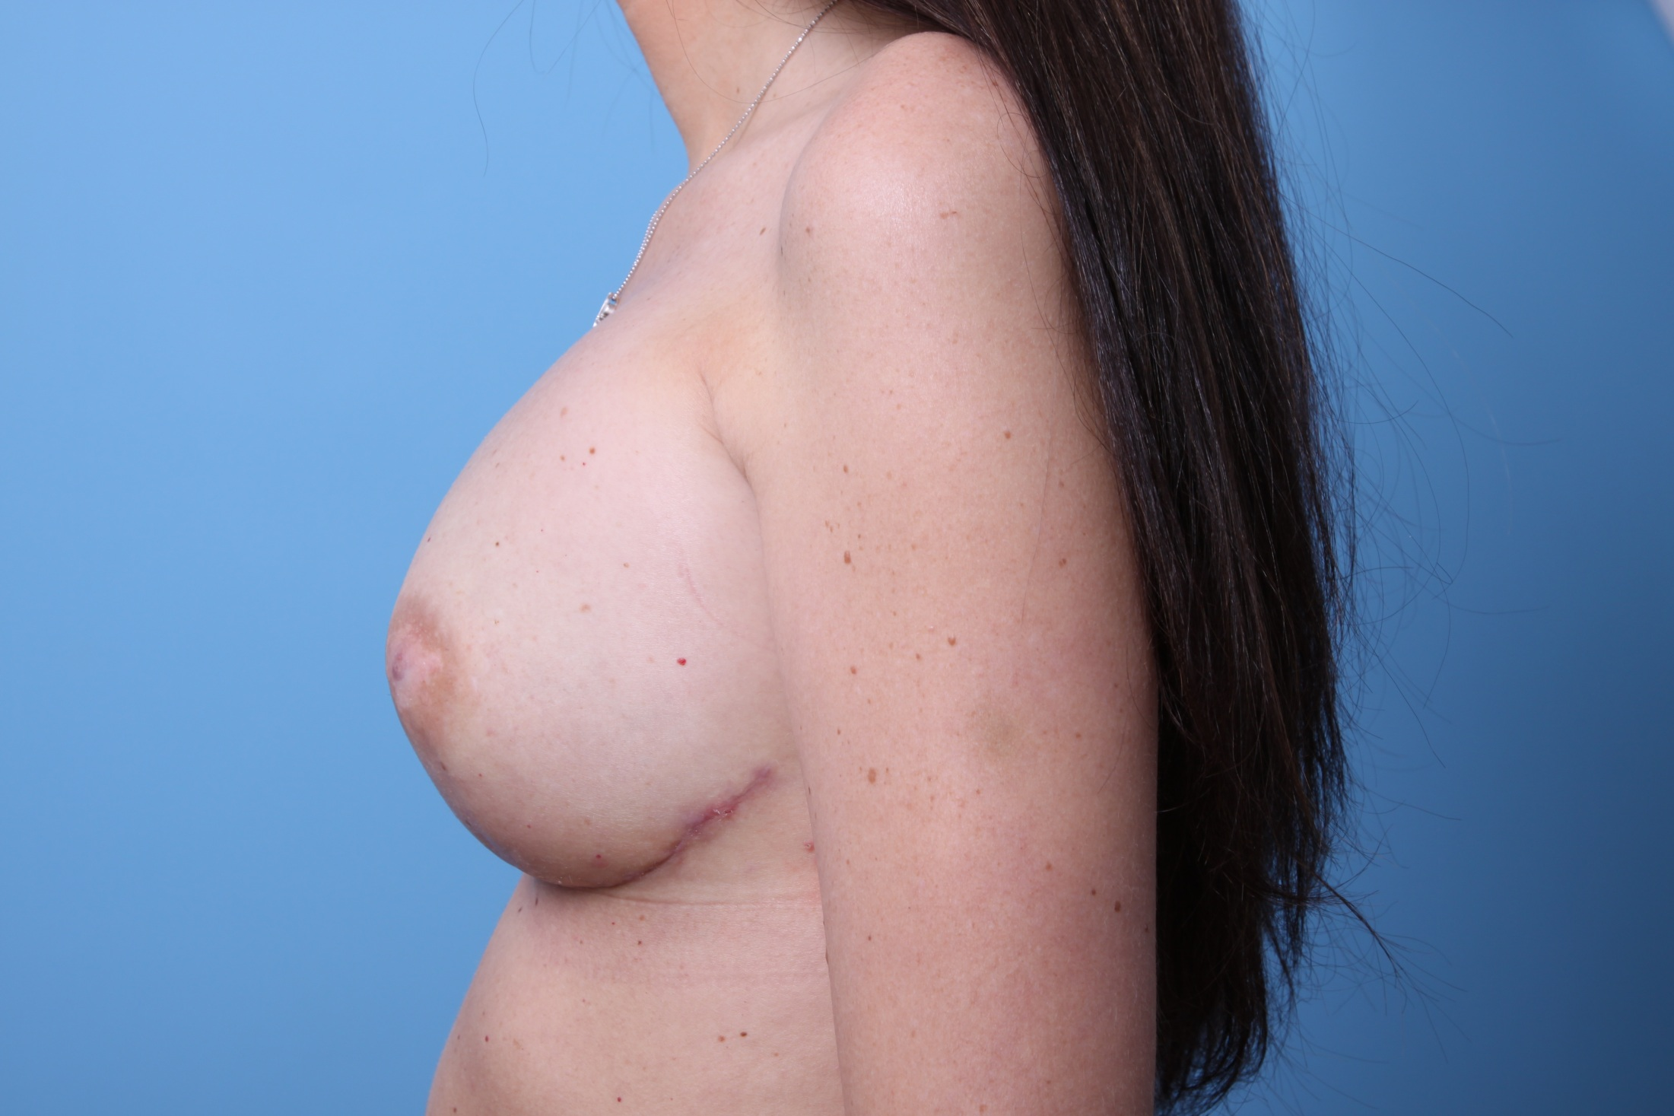

Slide 47


Slide 48


Slide 49
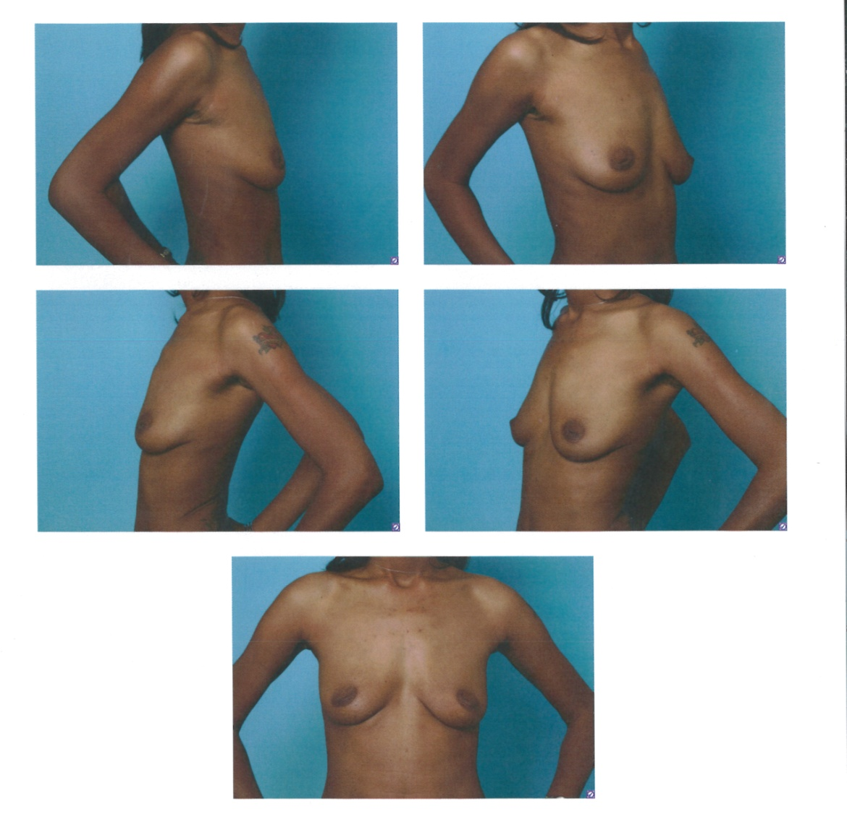
Before Mastectomy

Slide 50
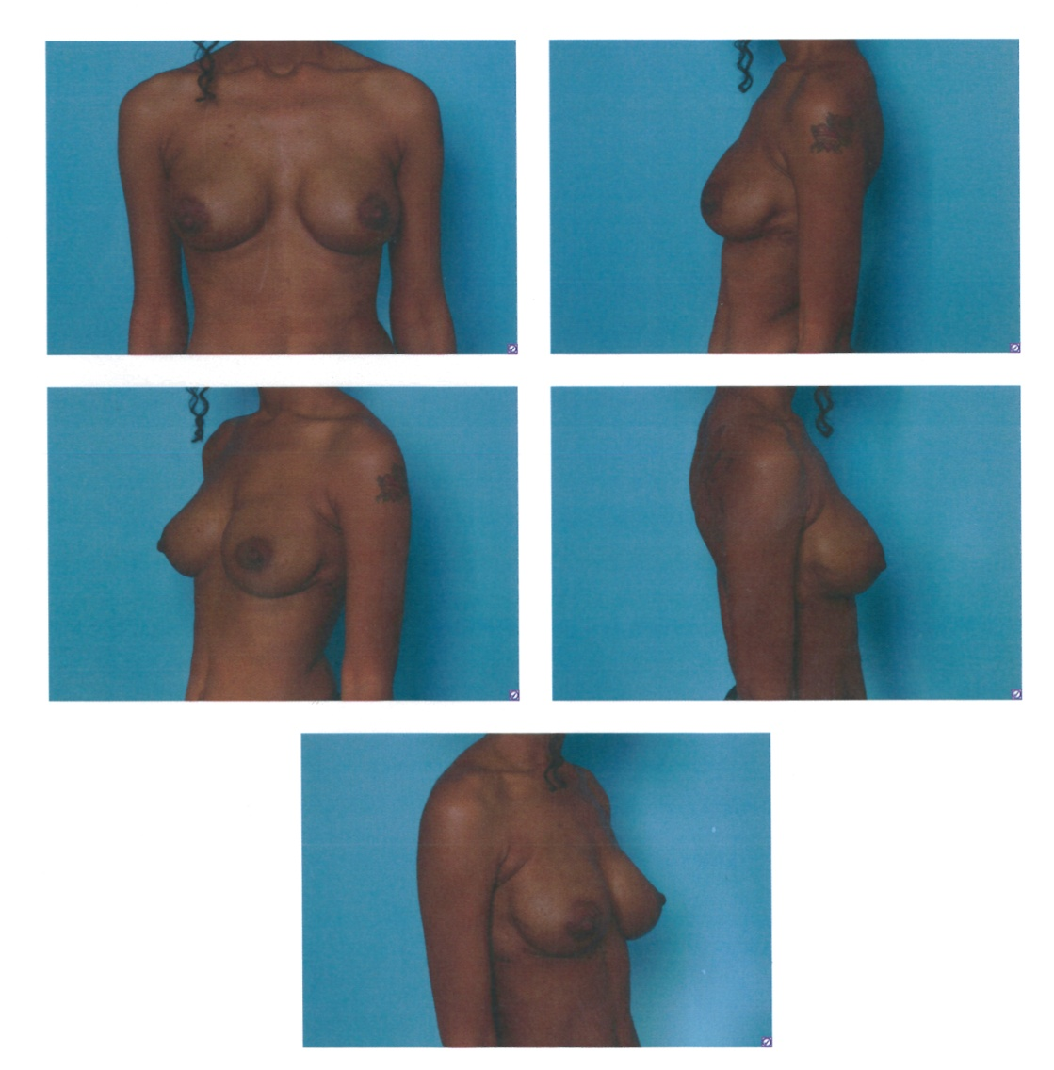
Cosmetic Results – Post Op

Slide 51
Acknowledgements
Ronald R. Hollins, MD
Perry J. Johnson, MD
Jason J. Miller, MD
Frederick L. Durden, MD
Debra A. Reilly, MD

Slide 52
Questions?
Thank you.

